Slide 1


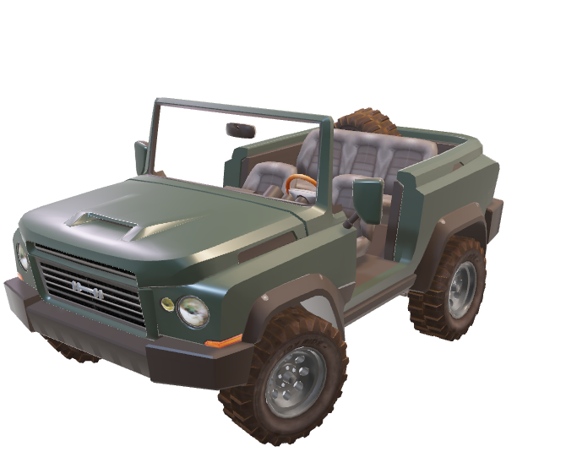
EVOLUTIONIZING THE TRANSPORT SECTOR

Slide 2

TODAY’S PROBLEMS:
DUE TO OVERPOPULATION TRANSPORTATION IS FACING SEVERE PROBLEMS LIKE NELIGENCE IN DETERMINATION OF CRIME AND DELAY IN SOLVING DAY TO DAY PROBLEMS THE TRANSPORT SECTOR IS FACING TODAY.
Some of the problems AI-Transporto is focusing to solve are on:
Chalans: This can include public harassment by the traffic police who otherwise are mismanaged by the state governments.
Vandalism: This can include damage to transportation vehicles, such as graffiti or broken windows, or damage to infrastructure, such as cutting cables or tampering with signals.
Medication: Transportation systems have become more fatal which requires intensive watch towards people and their driving habbits.
Human-trafficking: Transportation systems can be used to transport people for the purposes of exploitation, including forced labor and sexual exploitation.

Slide 3
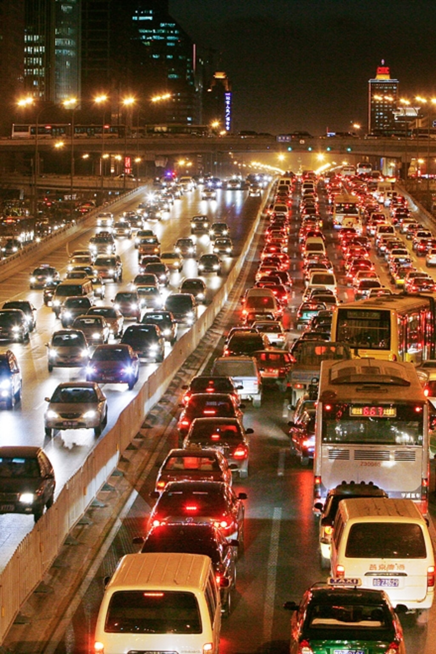
HOW IS IT BAD ?
People are losing faith on governments and are focusing on going anti-government which violated the principle of togetherness and the constitution.
Crime rates are increasing with the police having hardly any knowhow of the crime committed due to their negligence or human error.
People are getting frustrated from the current means of transporting and the government has to induce much more laws which makes the situation even worse.

Slide 4
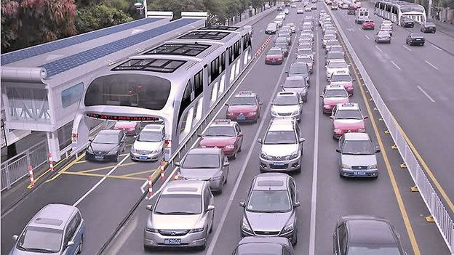
SOLUTION
Cameras should be programmed as to detect only clear license plate (will call it: lp-cameras).
Introduce AI in transport sector by identifying each vehicle and noting up their Aadhar details.
Storing data of license plate and linking it with user's Aadhar card.
The license plates must introduce a non-removable QR system which when scanned by the lp-cameras.
Simplifying the process of faulty driving fee with the eradication of chalans by directly imposing penalties on the user of the vehicle and deducting the penalty directly from the bank account.
Introducing disaster relief by getting the info about the user through a website which shall store the details of the user across.

Slide 5
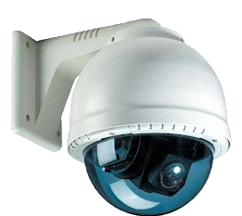
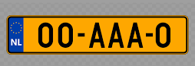
LP-CAMERA
Only QR Scanner for license plates. At first we need to renovate the license plates by introducing a QR systems in it. LP-Cameras can be installed at traffic junctions or poles at road. This camera will catch the license number of any violating drivers on the way.
In the AI-Transporto website one can search the license plate number and get the details of the person through their aadhar card. If any accident or any medical help occurs, the AI-Transporto web application can provide with the correct blood group of the person along with his location and send message to his/her families regarding the incident.

Slide 6

HOW WILL WE ACHIEVE IT?
We will seek government support to promote this website under government rules and regulations and make more users log in to this web application. This web will require the registration of their cars by giving their Aadhar card details and other necessary stuffs which can only be accessed by security officials or police personnels on proper demand of it.
Moreover we will not force any individual but promote the awareness of what we want for a better future of our country as the fastest growing economy. Moreover we will promote any further ideas from the customers and review them from our website and make our updates specific to what the major demand arises. We do not think of profit or loss as long as we make some positive contribution to the people.

Slide 7




DESIGNED AND CREATED BY
SHASWATA SAHA
A STUDENT
WEBSITE DEVELOPER
WORDPRESS DEVELOPER
FRONT END ENGINEER
DEVELOPER
CYBERSECURITY ANALYST
DATA ENGINEER
JAVA DEVELOPER
COMPUTER SCIENCE ENGINEER
3D MODELLER
GRAPHICS DESIGNER
UI DESIGNER
VIDEO EDITOR
PHOTOGRAPHER
Linkedin
GitHub
Twitter
shaswata.ssaha@gmail.com

